Slide 1
Deepracing
Autonomous F1 Driving
for maximized
Safety and Agility

Slide 2
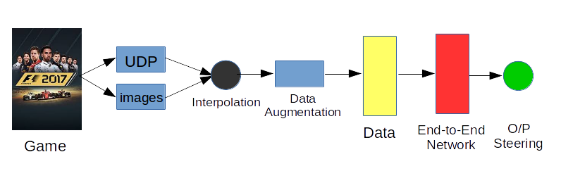
Training-Pipeline

Slide 3
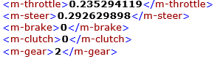
UDP Data

Slide 4
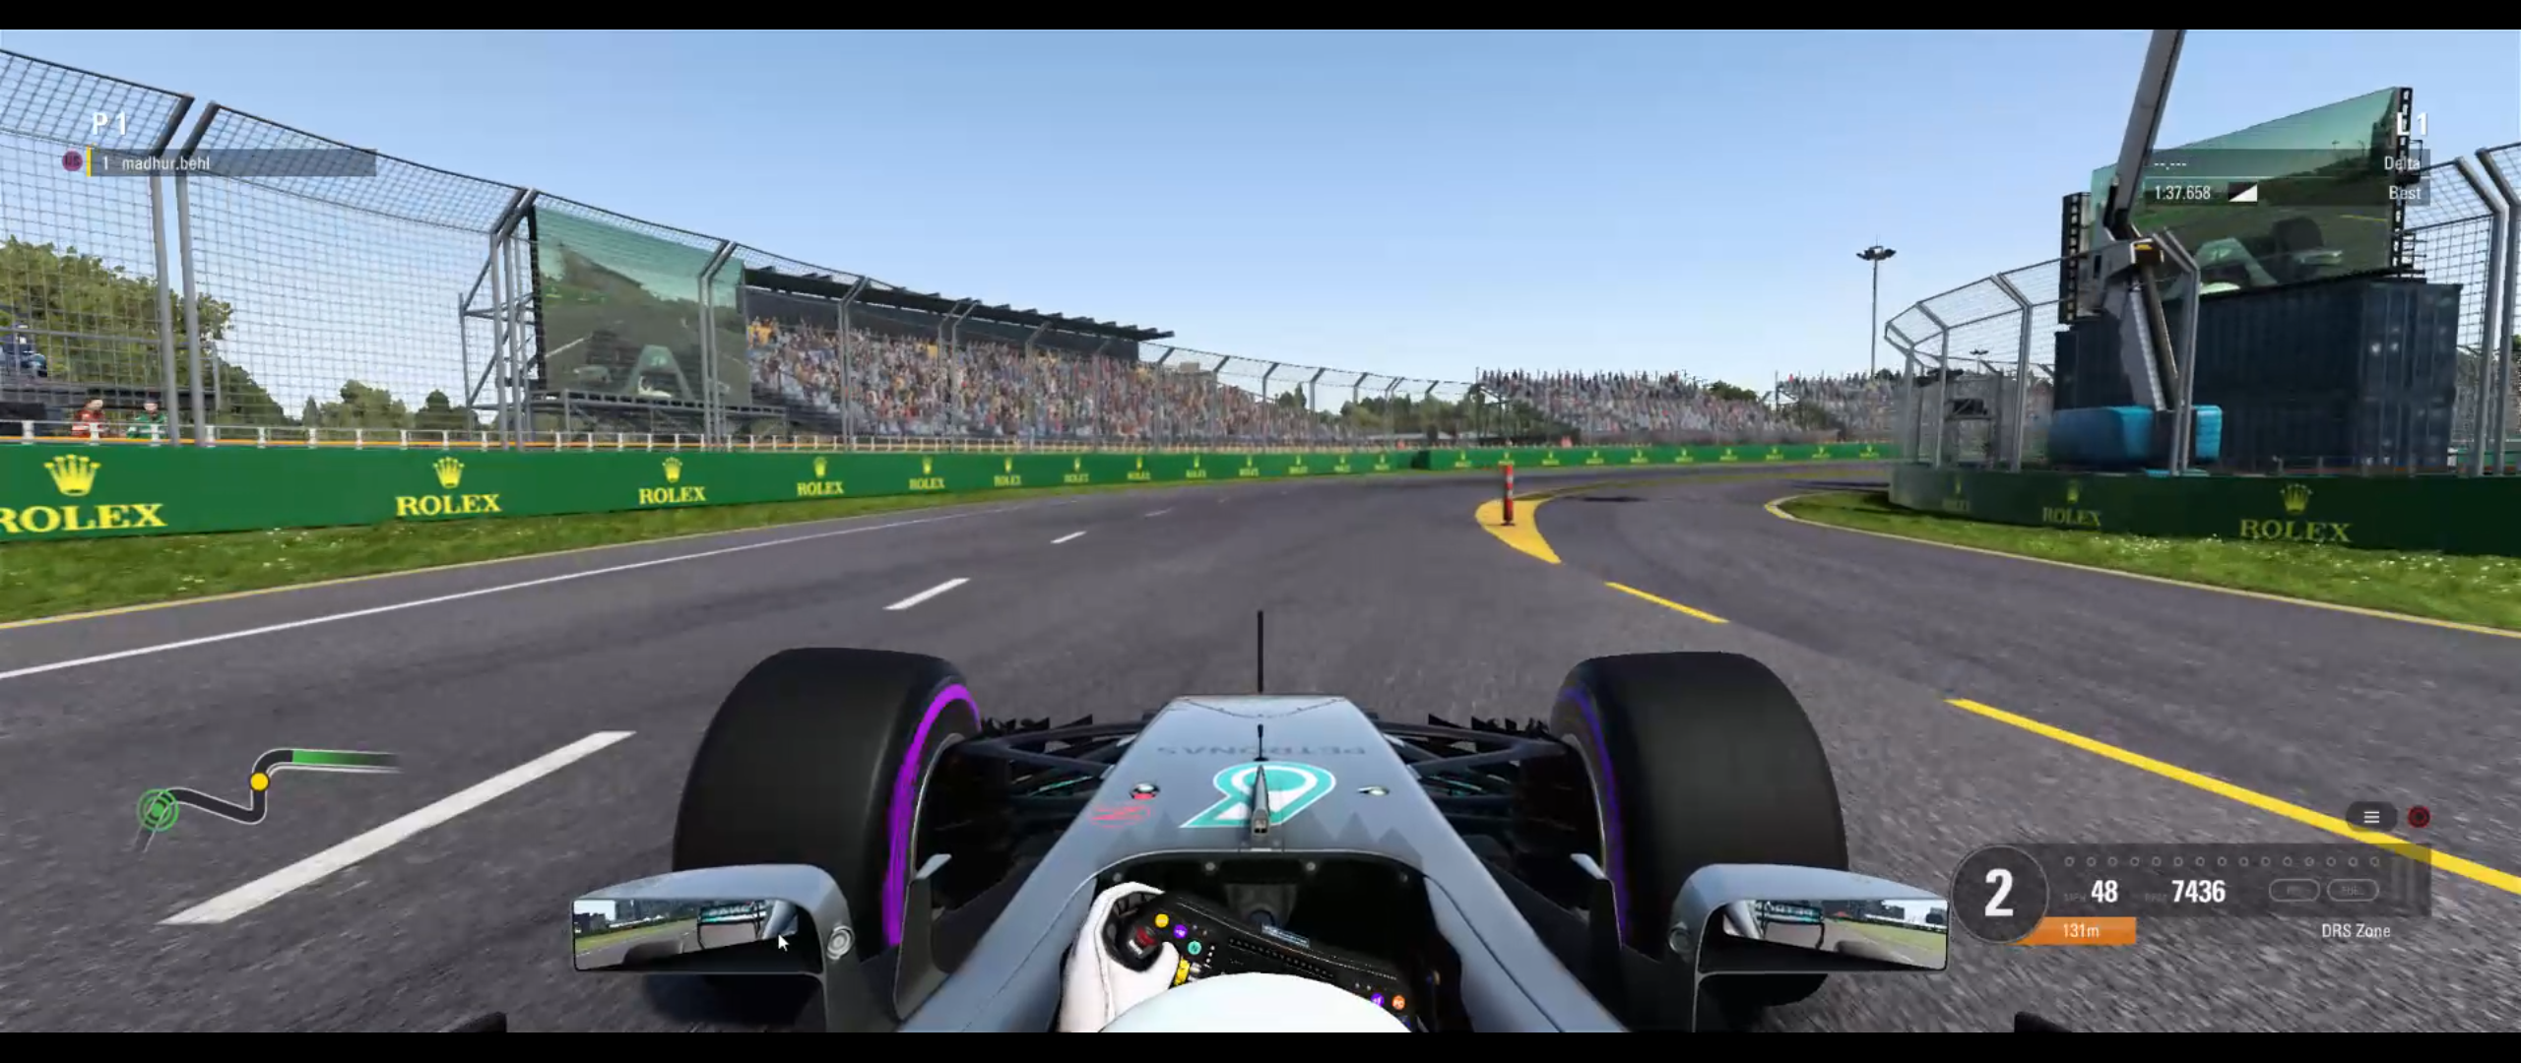
Image Data

Slide 5
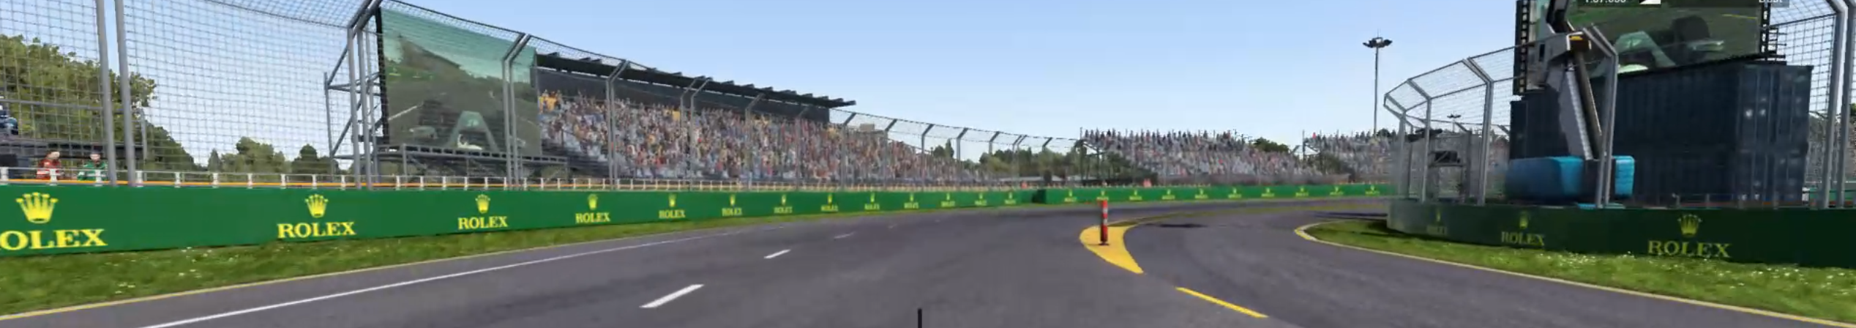
Image Data after Cropping

Slide 6
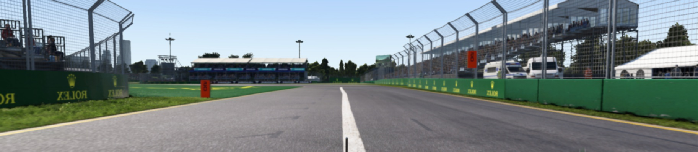
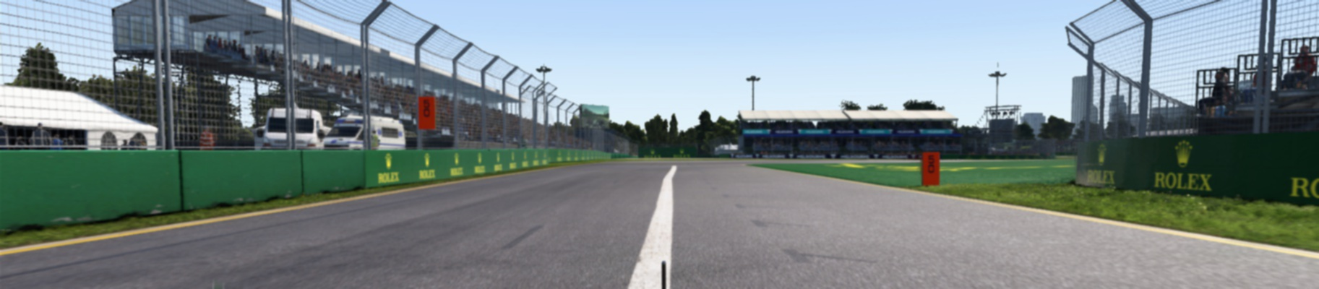
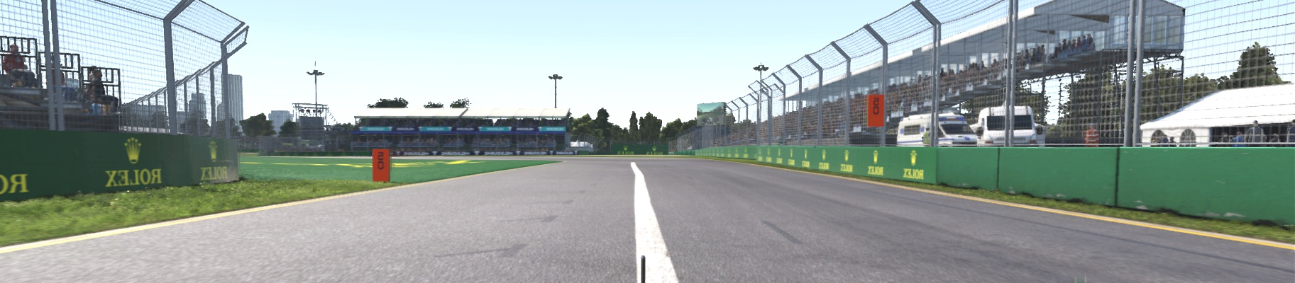
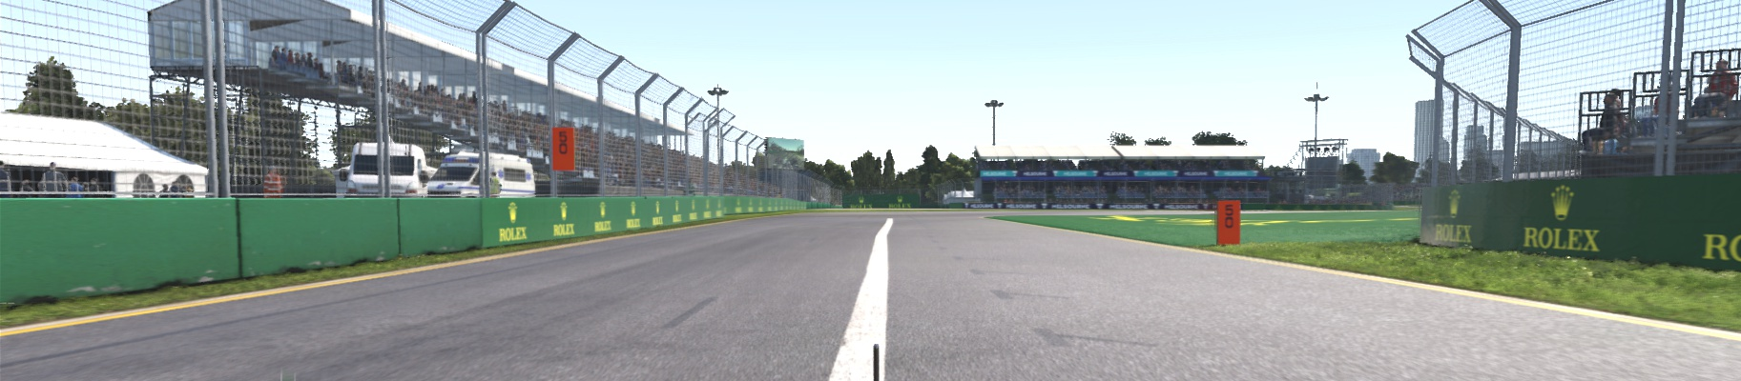
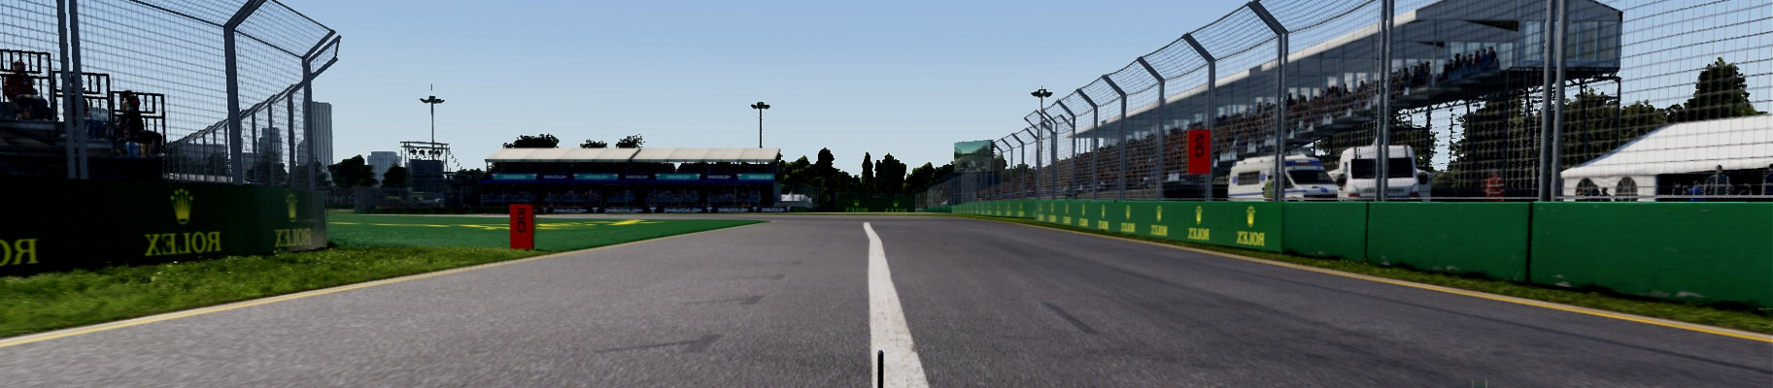
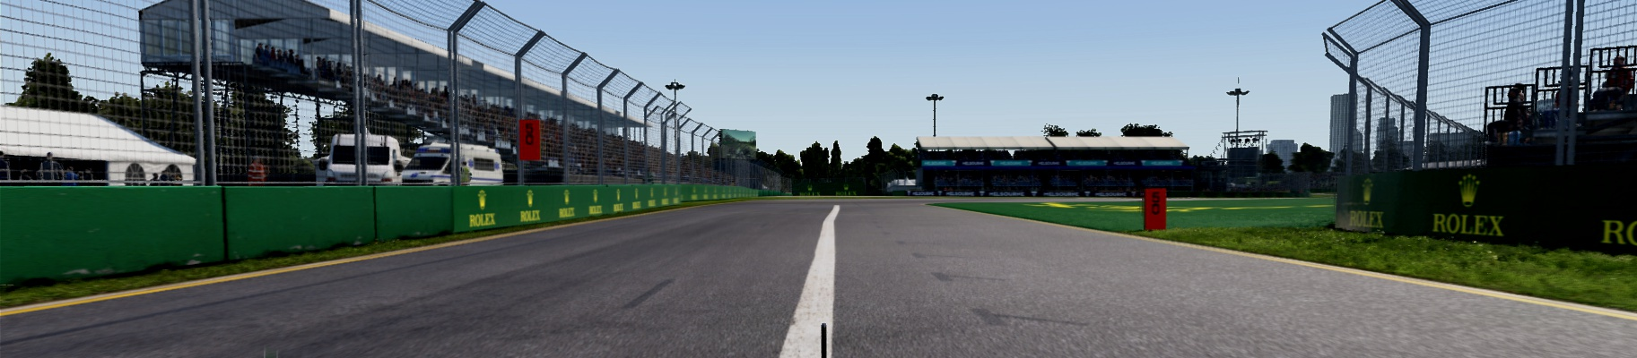


Data Augmentation

Slide 7
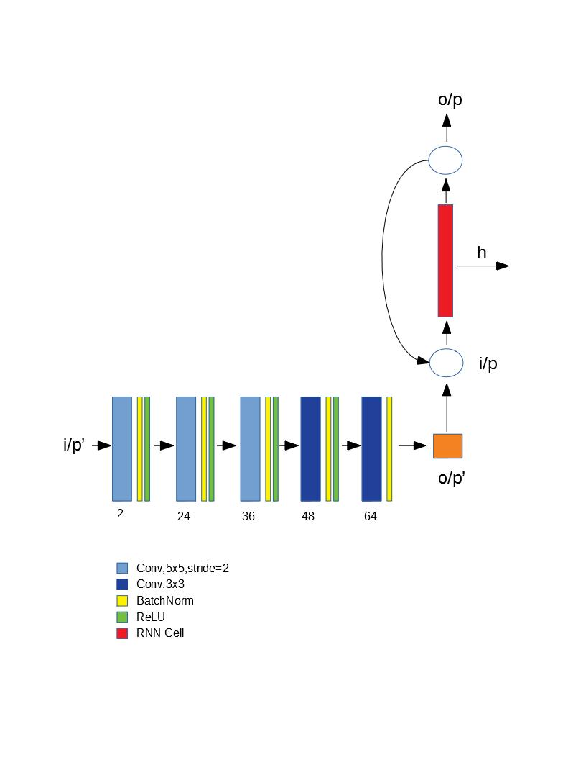
End-to-End Network

Slide 8
Testing
F1 Game testing
F1/10 Stream Testing
Real-Video testing

Slide 9
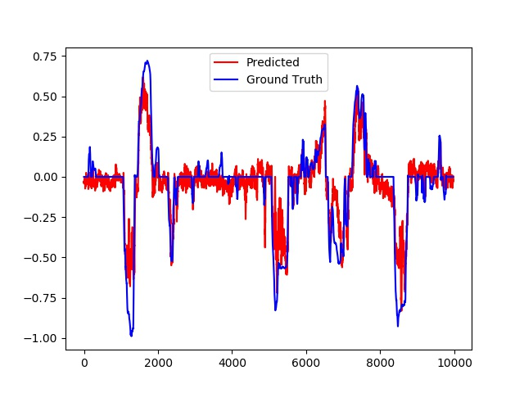
F1 Game Testing
RMS Error: 0.13630141902224283
NRMS Error: 0.8630448392385943

Slide 10
F1 Game Testing Video

Slide 11
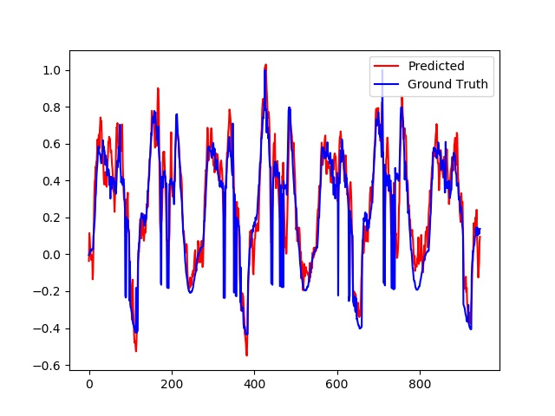
F1/10 Stream Testing
RMS Error: 0.14322563161278742
NRMS Error: 0.1438140864191006

Slide 12
F1/10 Stream Testing Video

Slide 13
Real-Video-Test

Slide 14
Thank You

